Slide 1
Image Enhancement
(Spatial Filtering)
Subhadip Basu, Ph.D.
Department of Computer Science and Engineering,
Jadavpur University

Slide 2
Contents
In this lecture we will look at spatial filtering techniques:
  Neighbourhood operations
  What is spatial filtering?
  Smoothing operations
  What happens at the edges?
  Correlation and convolution

Slide 3
Neighbourhood Operations
Neighbourhood operations simply operate on a larger neighbourhood of pixels than point operations
Neighbourhoods are
mostly a rectangle
around a central pixel
Any size rectangle
and any shape filter
are possible
Origin
x
(x, y)
Neighbourhood
y
Image f (x, y)

Slide 4
Simple Neighbourhood Operations
Some simple neighbourhood operations include:
  Min: Set the pixel value to the minimum in the neighbourhood
  Max: Set the pixel value to the maximum in the neighbourhood
  Median: The median value of a set of numbers is the midpoint value in that set (e.g. from the set [1, 7, 15, 18, 24] 15 is the median). Sometimes the median works better than the average

Slide 5
Simple Neighbourhood Operations Example
Original Image
x
Enhanced Image
x
123
127
128
119
115
130
140
145
148
153
167
172
133
154
183
192
194
191
194
199
207
210
198
195
164
170
175
162
173
151
y
y

Slide 6
The Spatial Filtering Process
Origin
x
a
b
c
r
s
t
d
e
f
*
u
v
w
g
h
i
x
y
z
Original Image Pixels
Filter
Simple 3*3
Neighbourhood
e
3*3 Filter
e_{processed} = v*e +
r*a + s*b + t*c +
u*d + w*f +
x*g + y*h + z*i
y
Image f (x, y)
The above is repeated for every pixel in the original image to generate the filtered image

Slide 7
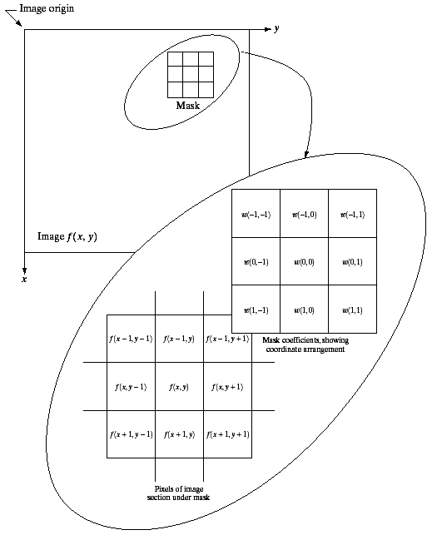
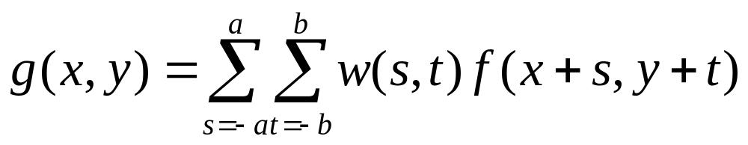

Spatial Filtering: Equation Form
Filtering can be given in equation form as shown above
Notations are based on the image shown to the left
Images taken from Gonzalez & Woods, Digital Image Processing (2002)

Slide 8
Smoothing Spatial Filters
One of the simplest spatial filtering operations we can perform is a smoothing operation
  Simply average all of the pixels in a neighbourhood around a central value
  Especially useful
  in removing noise
  from images
  Also useful for
  highlighting gross
  detail
¹/₉ | ¹/₉ | ¹/₉
¹/₉ | ¹/₉ | ¹/₉
¹/₉ | ¹/₉ | ¹/₉
Simple averaging filter

Slide 9
Smoothing Spatial Filtering
Origin
x
104
100
108
¹/₉
¹/₉
¹/₉
99
106
98
*
¹/₉
¹/₉
¹/₉
95
90
85
¹/₉
¹/₉
¹/₉
Original Image Pixels
Filter
¹/₉
¹/₉
¹/₉
Simple 3*3
Neighbourhood
104
100
108
3*3 Smoothing
Filter
¹/₉
¹/₉
¹/₉
99
106
98
¹/₉
¹/₉
¹/₉
95
90
85
e = ¹/₉*106 +
¹/₉*104 + ¹/₉*100 + ¹/₉*108 +
¹/₉*99 + ¹/₉*98 +
¹/₉*95 + ¹/₉*90 + ¹/₉*85
= 98.3333
y
Image f (x, y)
The above is repeated for every pixel in the original image to generate the smoothed image

Slide 10
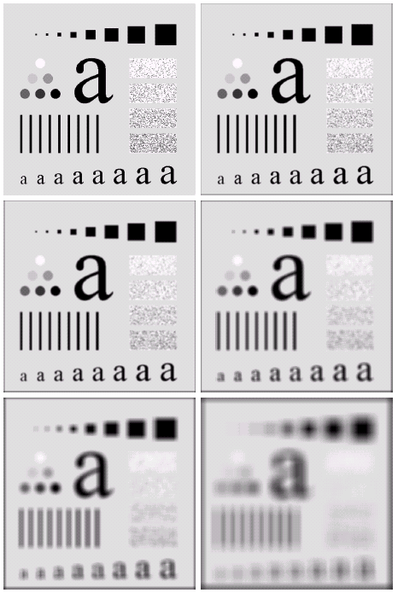
Image Smoothing Example
The image at the top left
is an original image of
size 500*500 pixels
The subsequent images
show the image after
filtering with an averaging
filter of increasing sizes
  3, 5, 9, 15 and 35
Notice how detail begins
to disappear
Images taken from Gonzalez & Woods, Digital Image Processing (2002)

Slide 11
Image Smoothing Example
Images taken from Gonzalez & Woods, Digital Image Processing (2002)

Slide 12
Image Smoothing Example
Images taken from Gonzalez & Woods, Digital Image Processing (2002)

Slide 13
Image Smoothing Example
Images taken from Gonzalez & Woods, Digital Image Processing (2002)

Slide 14
Image Smoothing Example
Images taken from Gonzalez & Woods, Digital Image Processing (2002)

Slide 15
Image Smoothing Example
Images taken from Gonzalez & Woods, Digital Image Processing (2002)

Slide 16
Image Smoothing Example
Images taken from Gonzalez & Woods, Digital Image Processing (2002)

Slide 17
Weighted Smoothing Filters
More effective smoothing filters can be generated by allowing different pixels in the neighbourhood different weights in the averaging function
  Pixels closer to the
  central pixel are more
  important
  Often referred to as a
  weighted averaging
¹/₁₆ | ²/₁₆ | ¹/₁₆
²/₁₆ | ⁴/₁₆ | ²/₁₆
¹/₁₆ | ²/₁₆ | ¹/₁₆
Weighted averaging filter

Slide 18
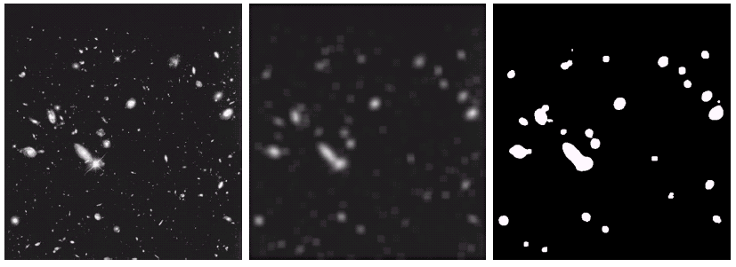
Another Smoothing Example
By smoothing the original image we get rid of lots of the finer detail which leaves only the gross features for thresholding
Images taken from Gonzalez & Woods, Digital Image Processing (2002)
Original Image
Smoothed Image
Thresholded Image

Slide 19

Averaging Filter Vs. Median Filter Example
Original Image
With Noise
Image After
Averaging Filter
Image After
Median Filter
Images taken from Gonzalez & Woods, Digital Image Processing (2002)
Filtering is often used to remove noise from images
Sometimes a median filter works better than an averaging filter

Slide 20
Averaging Filter Vs. Median Filter Example
Images taken from Gonzalez & Woods, Digital Image Processing (2002)

Slide 21
Averaging Filter Vs. Median Filter Example
Images taken from Gonzalez & Woods, Digital Image Processing (2002)

Slide 22
Averaging Filter Vs. Median Filter Example
Images taken from Gonzalez & Woods, Digital Image Processing (2002)

Slide 23
Simple Neighbourhood Operations Example
x
123
127
128
119
115
130
140
145
148
153
167
172
133
154
183
192
194
191
194
199
207
210
198
195
164
170
175
162
173
151
y

Slide 24
Strange Things Happen At The Edges!
At the edges of an image we are missing pixels to form a neighbourhood
Origin
x
e
e
e
e
e
e
e
y
Image f (x, y)

Slide 25
Strange Things Happen At The Edges! (cont…)
There are a few approaches to dealing with missing edge pixels:
  Omit missing pixels
    Only works with some filters
    Can add extra code and slow down processing
  Pad the image
    Typically with either all white or all black pixels
  Replicate border pixels
  Truncate the image
  Allow pixels wrap around the image
    Can cause some strange image artefacts

Slide 26
Simple Neighbourhood Operations Example
x
123
127
128
119
115
130
140
145
148
153
167
172
133
154
183
192
194
191
194
199
207
210
198
195
164
170
175
162
173
151
y

Slide 27




Strange Things Happen At The Edges! (cont…)
Filtered Image: Zero Padding
Original
Image
Filtered Image: Replicate Edge Pixels
Images taken from Gonzalez & Woods, Digital Image Processing (2002)
Filtered Image:
Wrap Around Edge Pixels

Slide 28
Strange Things Happen At The Edges! (cont…)
Images taken from Gonzalez & Woods, Digital Image Processing (2002)

Slide 29
Strange Things Happen At The Edges! (cont…)
Images taken from Gonzalez & Woods, Digital Image Processing (2002)

Slide 30
Strange Things Happen At The Edges! (cont…)
Images taken from Gonzalez & Woods, Digital Image Processing (2002)

Slide 31
Correlation & Convolution
The filtering we have been talking about so far is referred to as correlation with the filter itself referred to as the correlation kernel
Convolution is a similar operation, with just one subtle difference
For symmetric filters it makes no difference
a
b
c
r
s
t
e_{processed} = v*e +
z*a + y*b + x*c +
w*d + u*e +
t*f + s*g + r*h
d
e
e
*
u
v
w
f
g
h
x
y
z
Original Image Pixels
Filter

Slide 32
Summary
In this lecture we have looked at the idea of spatial filtering and in particular:
  Neighbourhood operations
  The filtering process
  Smoothing filters
  Dealing with problems at image edges when using filtering
  Correlation and convolution
Next time we will looking at sharpening filters and more on filtering and image enhancement

Slide 33
Spatial Filtering Refresher
Origin
x
a
b
c
r
s
t
d
e
f
*
u
v
w
g
h
i
x
y
z
Original Image Pixels
Filter
Simple 3*3
Neighbourhood
e
3*3 Filter
e_{processed} = v*e +
r*a + s*b + t*c +
u*d + w*f +
x*g + y*h + z*i
y
Image f (x, y)
The above is repeated for every pixel in the original image to generate the smoothed image

Slide 34
Sharpening Spatial Filters
Previously we have looked at smoothing filters which remove fine detail
Sharpening spatial filters seek to highlight fine detail
  Remove blurring from images
  Highlight edges
Sharpening filters are based on spatial differentiation

Slide 35
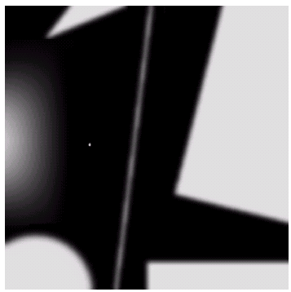
Spatial Differentiation
Differentiation measures the rate of change of a function
Let’s consider a simple 1 dimensional example
Images taken from Gonzalez & Woods, Digital Image Processing (2002)

Slide 36
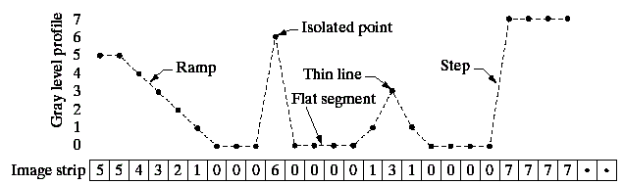
Spatial Differentiation
A
B
Images taken from Gonzalez & Woods, Digital Image Processing (2002)

Slide 37
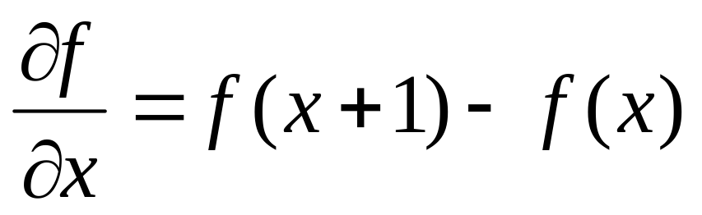
1st Derivative
The formula for the 1st derivative of a function is as follows:
It’s just the difference between subsequent values and measures the rate of change of the function

Slide 38
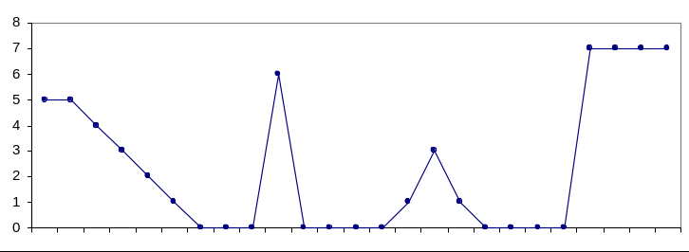
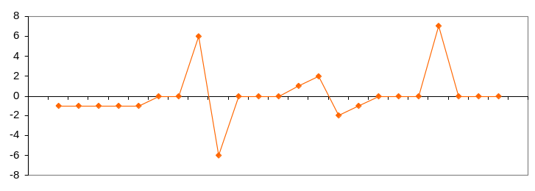
1st Derivative (cont…)
5 | 5 | 4 | 3 | 2 | 1 | 0 | 0 | 0 | 6 | 0 | 0 | 0 | 0 | 1 | 3 | 1 | 0 | 0 | 0 | 0 | 7 | 7 | 7 | 7
 | 0 | -1 | -1 | -1 | -1 | 0 | 0 | 6 | -6 | 0 | 0 | 0 | 1 | 2 | -2 | -1 | 0 | 0 | 0 | 7 | 0 | 0 | 0

Slide 39
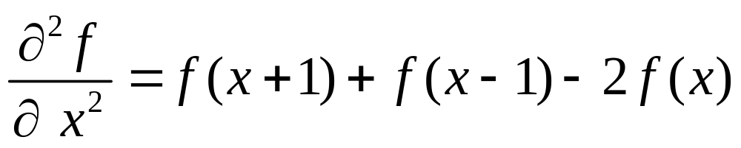
2nd Derivative
The formula for the 2nd derivative of a function is as follows:
Simply takes into account the values both before and after the current value

Slide 40
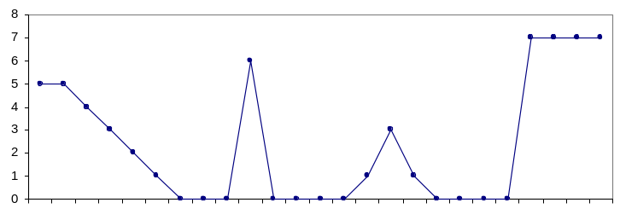
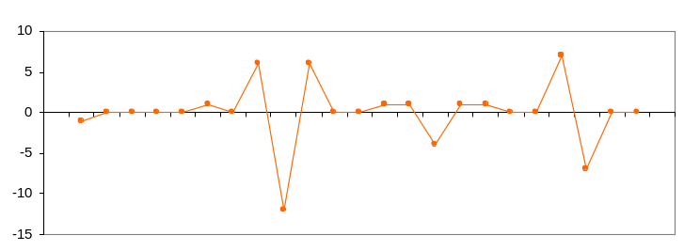
2nd Derivative (cont…)
5 | 5 | 4 | 3 | 2 | 1 | 0 | 0 | 0 | 6 | 0 | 0 | 0 | 0 | 1 | 3 | 1 | 0 | 0 | 0 | 0 | 7 | 7 | 7 | 7
 | -1 | 0 | 0 | 0 | 0 | 1 | 0 | 6 | -12 | 6 | 0 | 0 | 1 | 1 | -4 | 1 | 1 | 0 | 0 | 7 | -7 | 0 | 0

Slide 41
Using Second Derivatives For Image Enhancement
The 2nd derivative is more useful for image enhancement than the 1st derivative
  Stronger response to fine detail
  Simpler implementation
  We will come back to the 1st order derivative later on
The first sharpening filter we will look at is the Laplacian
  Isotropic
  One of the simplest sharpening filters
  We will look at a digital implementation

Slide 42
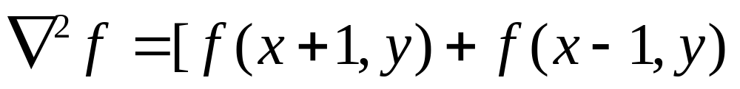
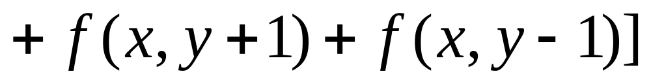
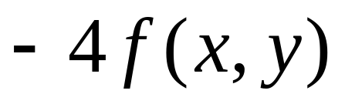
The Laplacian (cont…)
So, the Laplacian can be given as follows:
We can easily build a filter based on this
0
1
0
1
-4
1
0
1
0

Slide 43
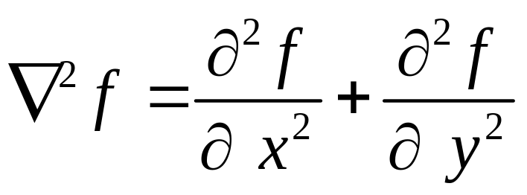
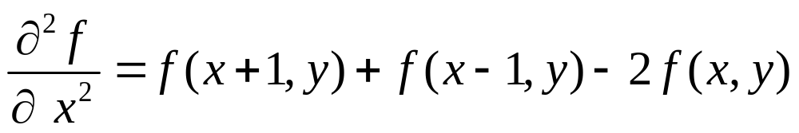
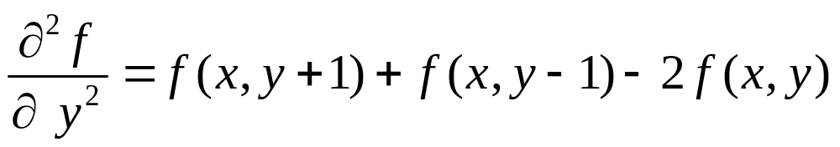
The Laplacian
The Laplacian is defined as follows:
where the partial 2nd order derivative in the x direction is defined as follows:
and in the y direction as follows:

Slide 44
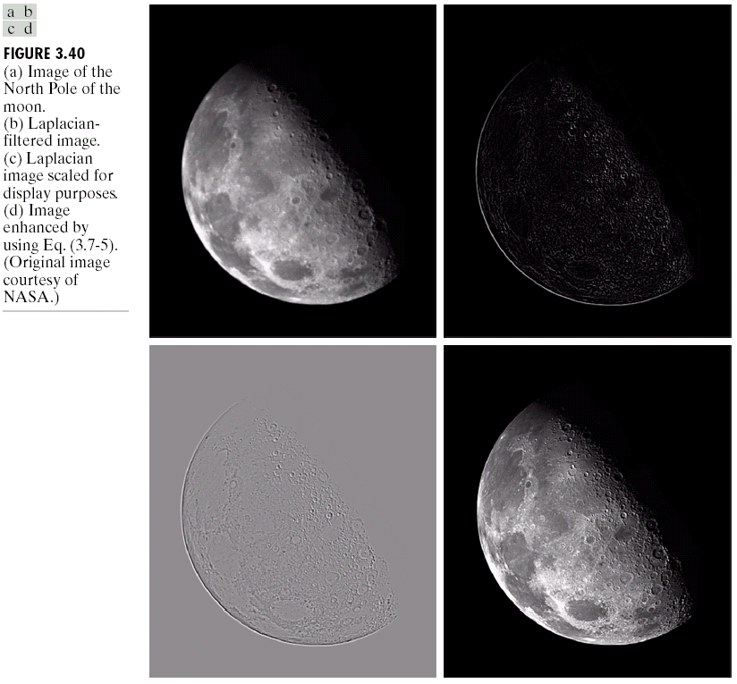
The Laplacian (cont…)
Applying the Laplacian to an image we get a new image that highlights edges and other discontinuities
Images taken from Gonzalez & Woods, Digital Image Processing (2002)
Original
Image
Laplacian
Filtered Image
Laplacian
Filtered Image
Scaled for Display

Slide 45
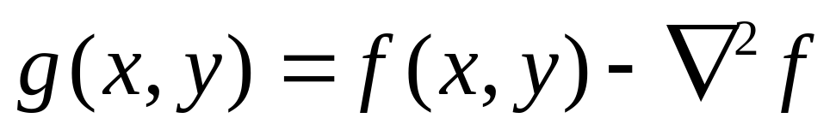
But That Is Not Very Enhanced!
The result of a Laplacian filtering is not an enhanced image
We have to do more work in order to get our final image
Subtract the Laplacian result from the original image to generate our final sharpened enhanced image
Images taken from Gonzalez & Woods, Digital Image Processing (2002)
Laplacian
Filtered Image
Scaled for Display

Slide 46
Laplacian Image Enhancement
-
=
Original
Image
Laplacian
Filtered Image
Sharpened
Image
Images taken from Gonzalez & Woods, Digital Image Processing (2002)
In the final sharpened image edges and fine detail are much more obvious

Slide 47
Laplacian Image Enhancement
Images taken from Gonzalez & Woods, Digital Image Processing (2002)

Slide 48
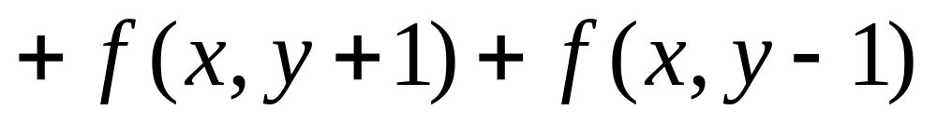
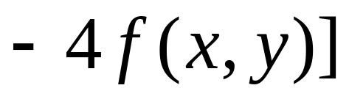
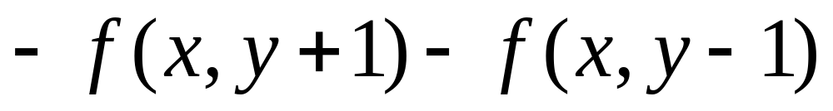
Simplified Image Enhancement
The entire enhancement can be combined into a single filtering operation

Slide 49
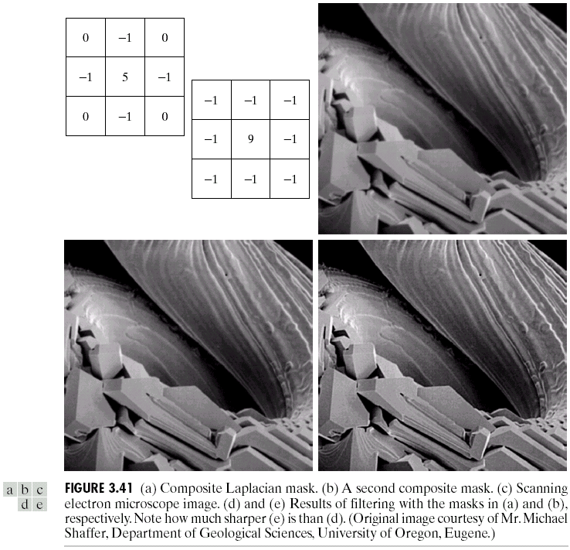
Simplified Image Enhancement (cont…)
This gives us a new filter which does the whole job for us in one step
0
-1
0
-1
5
-1
Images taken from Gonzalez & Woods, Digital Image Processing (2002)
0
-1
0

Slide 50
Simplified Image Enhancement (cont…)
Images taken from Gonzalez & Woods, Digital Image Processing (2002)

Slide 51
Variants On The Simple Laplacian
There are lots of slightly different versions of the Laplacian that can be used:
0
1
0
1
1
1
Simple
Laplacian
Variant of
Laplacian
1
-4
1
1
-8
1
0
1
0
1
1
1
Images taken from Gonzalez & Woods, Digital Image Processing (2002)
-1
-1
-1
-1
9
-1
-1
-1
-1

Slide 52
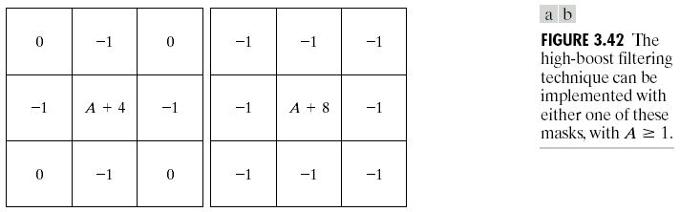
Unsharp masking and high-boost filtering
      unsharp masking
      high-boost filtering
Blurred image

Slide 53


Slide 54
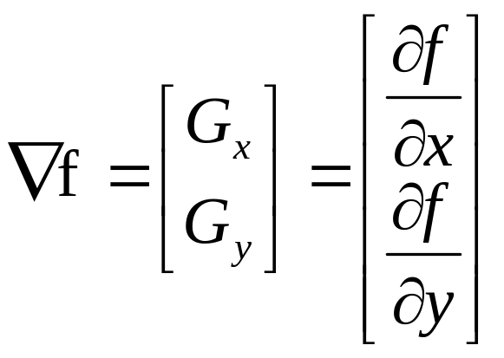
1st Derivative Filtering
Implementing 1st derivative filters is difficult in practice
For a function f(x, y) the gradient of f at coordinates (x, y) is given as the column vector:

Slide 55
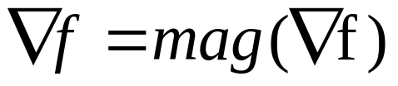
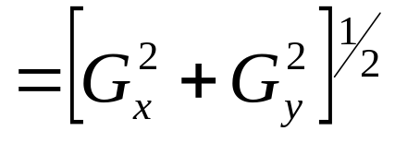
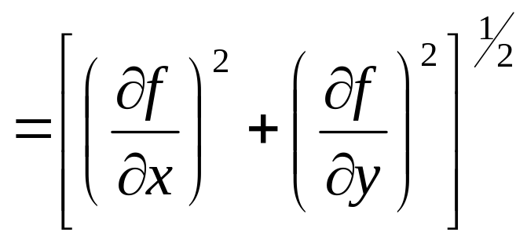
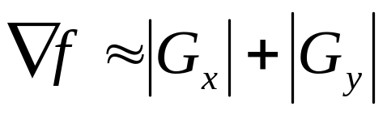
1st Derivative Filtering (cont…)
The magnitude of this vector is given by:
For practical reasons this can be simplified as:

Slide 56
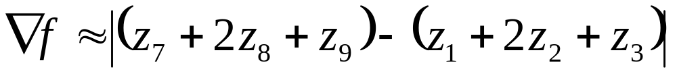
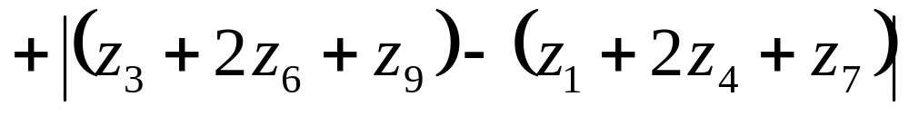
1st Derivative Filtering (cont…)
There is some debate as to how best to calculate these gradients but we will use:
which is based on these coordinates
z₁
z₂
z₃
z₄
z₅
z₆
z₇
z₈
z₉

Slide 57
Sobel Operators
Based on the previous equations we can derive the Sobel Operators
To filter an image it is filtered using both operators the results of which are added together
-1
-2
-1
-1
0
1
0
0
0
-2
0
2
1
2
1
-1
0
1

Slide 58
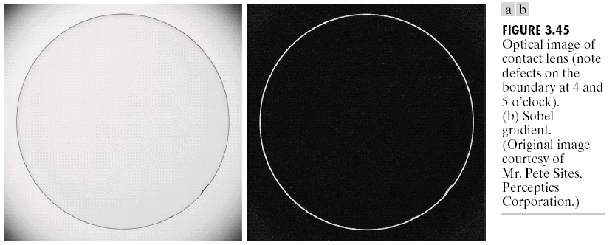
Sobel Example
Sobel filters are typically used for edge detection
An image of a contact lens which is enhanced in order to make defects (at four and five o’clock in the image) more obvious
Images taken from Gonzalez & Woods, Digital Image Processing (2002)

Slide 59
1st & 2nd Derivatives
Comparing the 1st and 2nd derivatives we can conclude the following:
  1st order derivatives generally produce thicker edges
  2nd order derivatives have a stronger response to fine detail e.g. thin lines
  1st order derivatives have stronger response to grey level step
  2nd order derivatives produce a double response at step changes in grey level

Slide 60
Summary
In this lecture we looked at:
  Sharpening filters
    1st derivative filters
    2nd derivative filters
  Combining filtering techniques

Slide 61
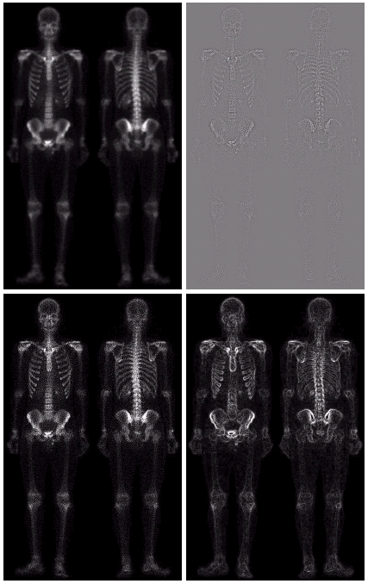
Combining Spatial Enhancement Methods
Successful image enhancement is typically not achieved using a single operation
Rather we combine a range of techniques in order to achieve a final result
This example will focus on enhancing the bone scan to the right
Images taken from Gonzalez & Woods, Digital Image Processing (2002)

Slide 62
Combining Spatial Enhancement Methods (cont…)
(a)
Images taken from Gonzalez & Woods, Digital Image Processing (2002)
Laplacian filter of bone scan (a)
(b)
Sharpened version of bone scan achieved by subtracting (a) and (b)
(c)
Sobel filter of bone scan (a)
(d)

Slide 63
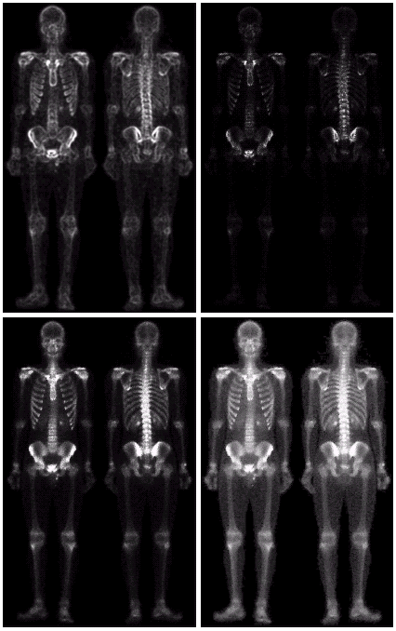
Combining Spatial Enhancement Methods (cont…)
Result of applying a power-law trans. to (g)
(h)
Sharpened image which is sum of (a) and (f)
(g)
The product of (c) and (e) which will be used as a mask
(f)
(e)
Images taken from Gonzalez & Woods, Digital Image Processing (2002)
Image (d) smoothed with a 5*5 averaging filter

Slide 64
Combining Spatial Enhancement Methods (cont…)
Compare the original and final images
Images taken from Gonzalez & Woods, Digital Image Processing (2002)

